Slide 1

ADVANCED RESEARCH CENTRE
for
INDIAN WRITING IN ENGLISH

Slide 2
The Context
Since the 1970s research in English Studies has undergone a radical change. The scope of English Literature Studies has extended from the canonical literature written in England to literatures written in English anywhere across the world. This has further extended to literatures translated into English.
An ancillary field has also developed that researches the growth of ‘other englishes’ as English language skills are mapped in terms of usages across the world. English Studies thus encompasses the study of Literatures in English (and englishes) with reference to social, economic, historic and cultural factors.
The field of Indian English Literature is today well entrenched both nationally and globally. The subject is part of the curriculum in higher education and is growing at a rapid pace in terms of production of literary texts, translations, critical studies and histories.
All this has changed the study of the traditional canonical ‘English’ texts as well.

Slide 3
The Beginning
In July 2014 an Advanced Research Centre for Indian Writing in English was sanctioned to the Post Graduate Department of English of the College by the University of Calcutta in order to promote and facilitate research in Indian English Literature.
Professor Krishna Sen and Professor Sanjukta Das became the Joint Directors, (External and Internal respectively), of the Centre.
Objectives of the Centre
To interact and collaborate with national and international centres of excellence
To promote interdisciplinary research
To publish books and journals or Occasional Research Paper series periodically

Slide 4
Activities of the Centre
Publications
Seminars
Workshops
Panel Discussions
Talks
Orientation Lectures on Modern Indian Literatures in Comparison

Slide 5
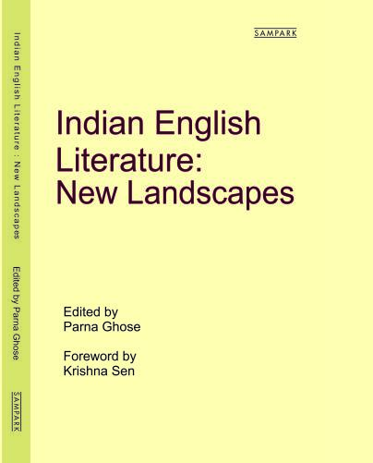
1. Publications
Book titled: Indian English Literature: New Landscapes (2019) ISBN: 9788177680294

Slide 6
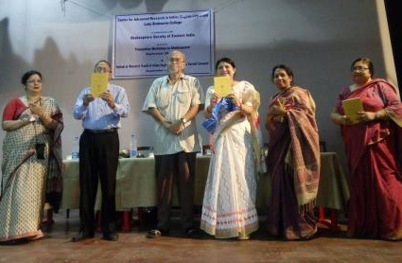
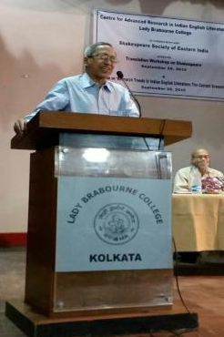
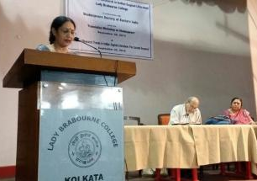
2. Seminars
State Level Seminar on ‘Research Trends in Indian English Literature: the current scenario’ organized in collaboration with Shakespeare Society of Eastern India on Wednesday, 29.09.2015.

Slide 7
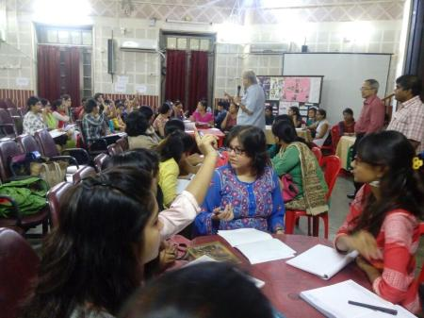
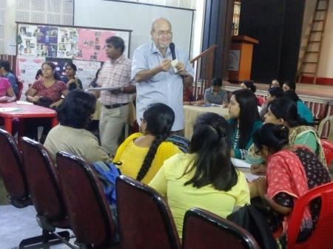
3. Workshops
Workshop on ‘Translation Theory and Praxis’ organized in collaboration with Shakespeare Society of Eastern India on Tuesday, 28.09.2015.

Slide 8
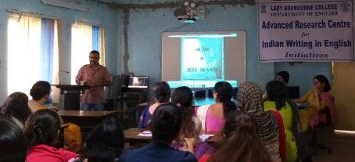
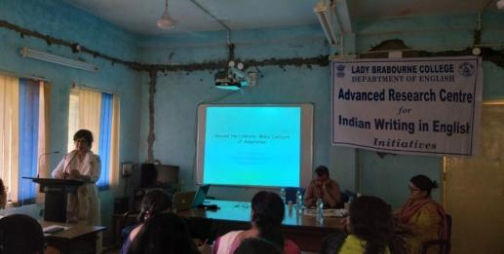
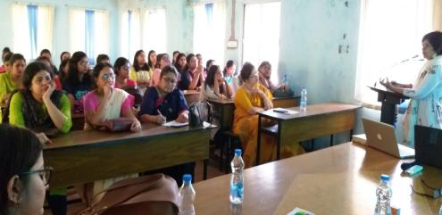
4. Panel Discussions
Panel Discussion on “Film Studies and Literary Adaptations”, organized on 28.03.2019. Panelists were from the Department of Film Studies, Jadavpur University and St. Xavier’s College, Kolkata.

Slide 9
5. Talks
Professor Krishna Sen of the University of Calcutta delivered a Talk on ‘Eco-criticism and Indian Writing in English’ at the Inauguration of the Advanced Research Centre for Indian Writing in English on 19th August, 2014.
Dr. Chandreyee Niyogi of Jadavpur University delivered a Talk on ‘Anthropocentrism in Literature’ on 5th December, 2014.
Professor Sobha Chatterjee of Jadavpur University delivered the Mandalika Banerji Endowment Lecture organized by the Centre in collaboration with the Alumnae Association of the College on 12th December, 2014.
Professor Subir Dhar of Rabindra Bharati University delivered a Talk on ‘Environment and Indian English Literature’ on 12th December, 2014.
Poet and academic Sri Debasish Lahiri of Lal Baba College, Belur, delivered a Talk titled “Poetry via Byculla: what has salvation got to do with it’ on 1st March, 2017.
Dr. Rangana Banerji of the University of Calcutta delivered a Talk on ‘English in India’ on 20th January, 2018.

Slide 10
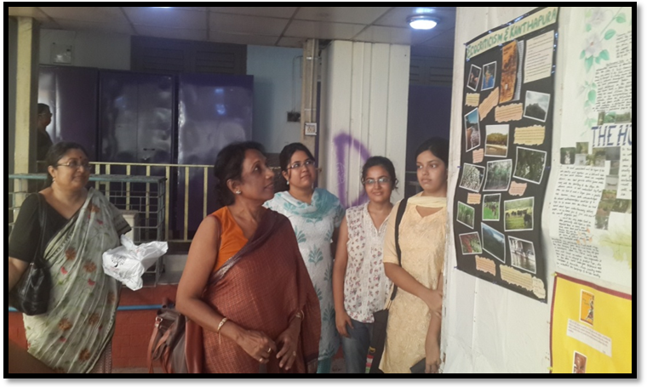
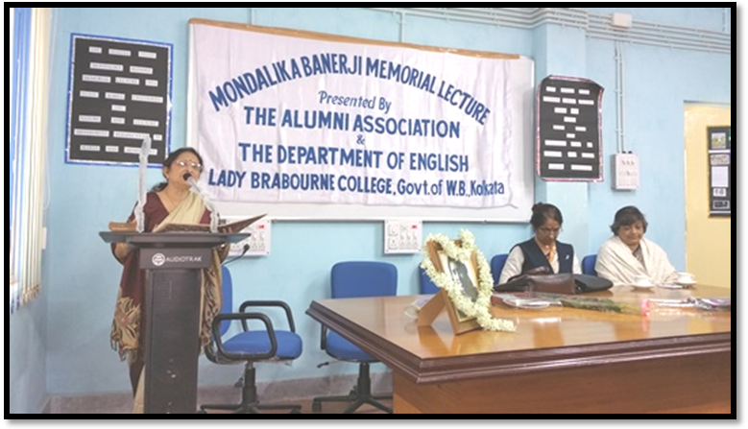
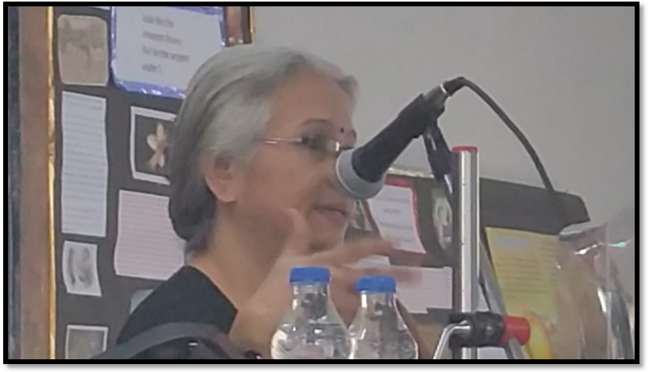
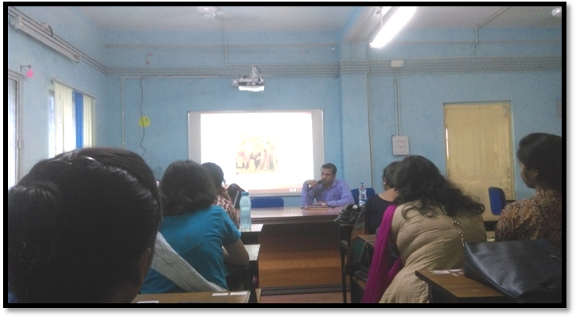

Slide 11
Future Plans
Continue with the Special Talks as they bring home to our PG students an array of ongoing research areas
Continue with the Lecture Series on Indian Writing in English and Literatures in Comparison
Organize collaborative seminars and panel discussions.
Put together another volume showcasing research trends.

Slide 12


